Slide 1

ECE 530 Cloud Computing
Ioannis Papapanagiotou
NoSQL Data Modeling

Slide 2
NoSQL Data Modeling
flexible schema. Unlike SQL databases, where you must determine and declare a table’s schema before inserting data.
This flexibility facilitates the mapping of documents to an entity or an object.
Each document can match the data fields of the represented entity, even if the data has substantial variation.
In practice, however, the documents in a collection share a similar structure.

Slide 3
Data Modeling Challenges
The key challenge in data modeling is balancing the needs of the application,
the performance characteristics of the database engine,
the data retrieval patterns.
When designing data models, always consider the application usage of the data (i.e. queries, updates, and processing of the data) as well as the inherent structure of the data itself.

Slide 4
NoSQL Data Structure
The key decision in designing data models for revolves around the structure of documents and how the application represents relationships between data.
There are two tools that allow applications to represent these relationships: references and embedded documents.

Slide 5
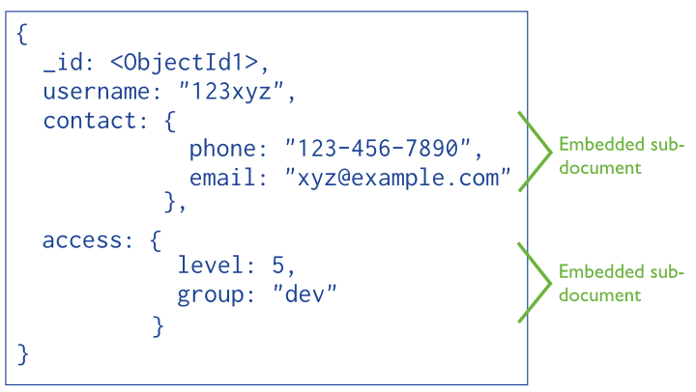
Embedded Documents
Embedded documents capture relationships between data by storing related data in a single document structure. In NoSQL documents make it possible to embed document structures as sub-documents in a field or array within a document.
Notes:
These denormalized data models allow applications to retrieve and manipulate related data in a single database operation.
Data model with embedded fields that contain all related information.

Slide 6
When to use embedded documents?
you have “contains” relationships between entities:
One-to-One Relationships
you have one-to-many relationships between entities.
In these relationships the “many” or child documents always appear with or are viewed in the context of the “one” or parent documents.
Embedding provides better performance for read operations, as well as the ability to request and retrieve related data in a single database operation.
Embedded data models make it possible to update related data in a single atomic write operation.
Notes:
References provides more flexibility than embedding. However, client-side applications must issue follow-up queries to resolve the references. In other words, normalized data models can require more roundtrips to the server.

Slide 7
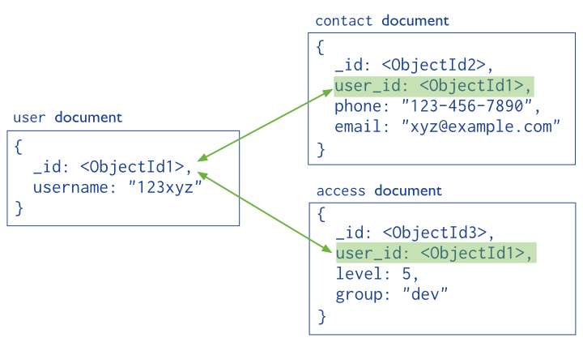
References
References store the relationships between data by including links or references from one document to another. Applications can resolve these references to access the related data.
Notes:
Data model using references to link documents. Both the contact document and the access document contain a reference to the user document.

Slide 8
When to use References?
In general, use normalized data models:
when embedding would result in duplication of data but would not provide sufficient read performance advantages to outweigh the implications of the duplication.
to represent more complex many-to-many relationships.
to model large hierarchical data sets.
References provides more flexibility than embedding. However, client-side applications must issue follow-up queries to resolve the references. In other words, normalized data models can require more round trips to the server.

Slide 9
Atomicity of Write Operations
Write operations are atomic at the document level, and no single write operation can atomically affect more than one document or more than one collection.
A denormalized data model with embedded data combines all related data for a represented entity in a single document.
This facilitates atomic write operations since a single write operation can insert or update the data for an entity.
Normalizing the data would split the data across multiple collections and would require multiple write operations that are not atomic collectively.

Slide 10
Query Processing NoSQL #1
NoSQL has some fundamental limitations that we need to be aware of.
It calls for a more relaxed data consistency model
It provides primitive querying and searching capability
Many of the NoSQL DB today is based on the DHT (Distributed Hash Table) model, which provides a hashtable access semantics.
To access or modify any object data, the client is required to supply the primary key of the object, then the DB will lookup the object using an equality match to the supplied key.

Slide 11
Query Processing NoSQL #2
For example, if we use DHT to implement a customer DB, we can choose the customer id as the key. And then we can get/set/operate on any customer object if we know its id
cust_data = DHT.get(cust_id)
DHT.set(cust_id, modified_cust_data)
DHT.execute(cust_id, func(cust) {cust.add_credit(200)})
In the real world, we may want to search data based on other attributes than its primary key, we may also search attributes based on
"greater/less than" relationship,
combine multiple search criteria using a boolean expression.

Slide 12
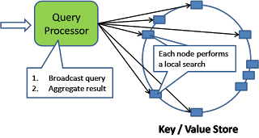
Scatter/Gather Local Search
Some of the NοSQL DB provides indexing and query processing mechanism within the local DB. In this case, we can have the query processor broadcast the query to every node in the DHT where a local search will be conducted with results sent back to the query processor which aggregates into a single response.

